Slide 1



ReEd Solomon decoder using uart
Giannis reinos | Dimitris tsalapatas
11-07-2023

Slide 2

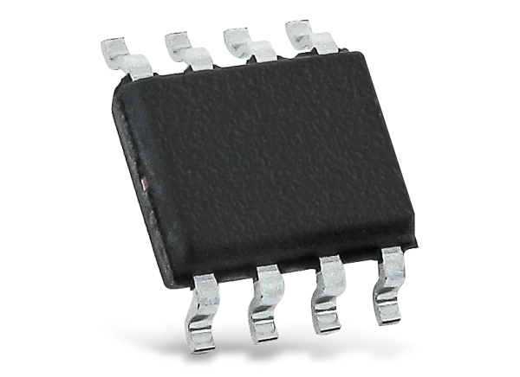


DESIGN APPLICATIONS
The purpose of the chip is to receive data from a Reed Solomon Encoder via UART and decode them using the Reed Solomon Decoder.
Uses in real world applications: Digital broadcasting, Mobile phone networks, CD and DVD storage, Data storage.

Slide 3
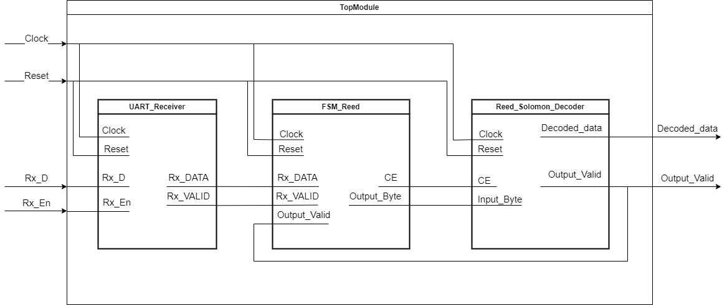
DESIGN DATAFLOW

Slide 4
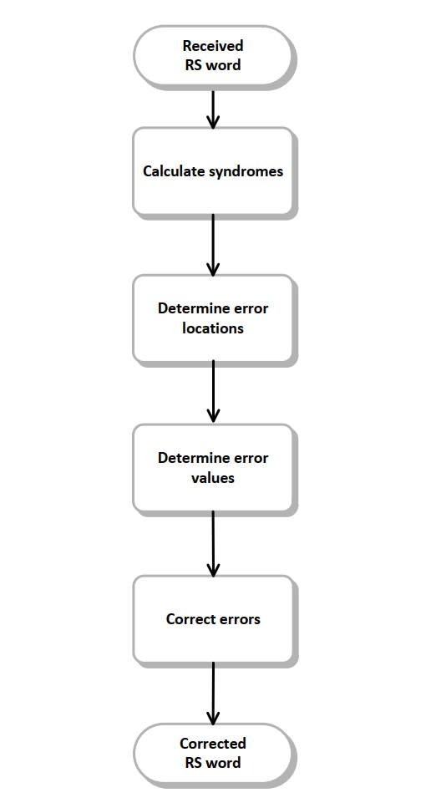
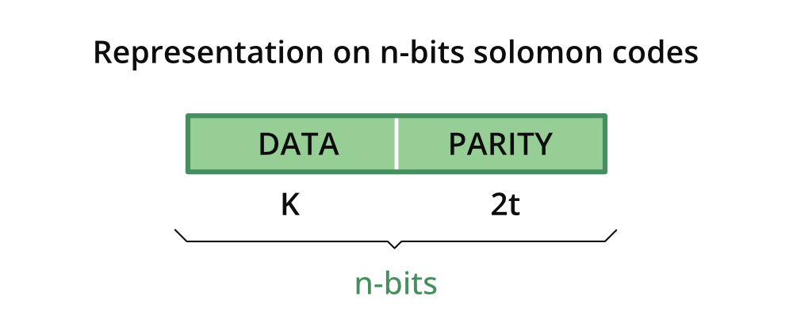
REED SOLOMON DECODER
Reed-Solomon decoding is a technique used to correct errors in data transmissions, particularly in digital communication systems. It is a type of forward error correction method that uses redundant information to detect and correct errors that may occur during transmission.

Slide 5
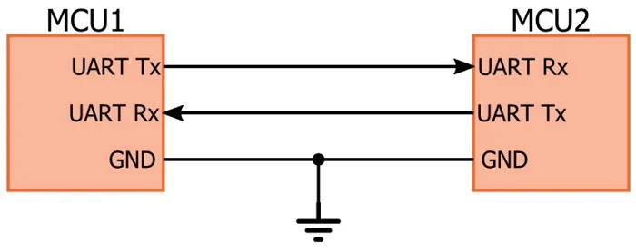
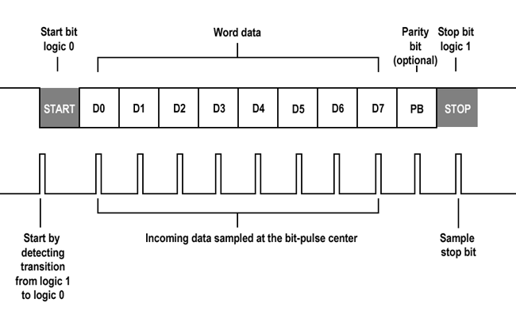
UART RECIEVER
We use UART Receiver to receive data from the Reed Solomon Encoder and to provide them for decoding in Decoder.
The speed of Serial communication is at baud rate 115200 which is the maximum speed for this protocol

Slide 6
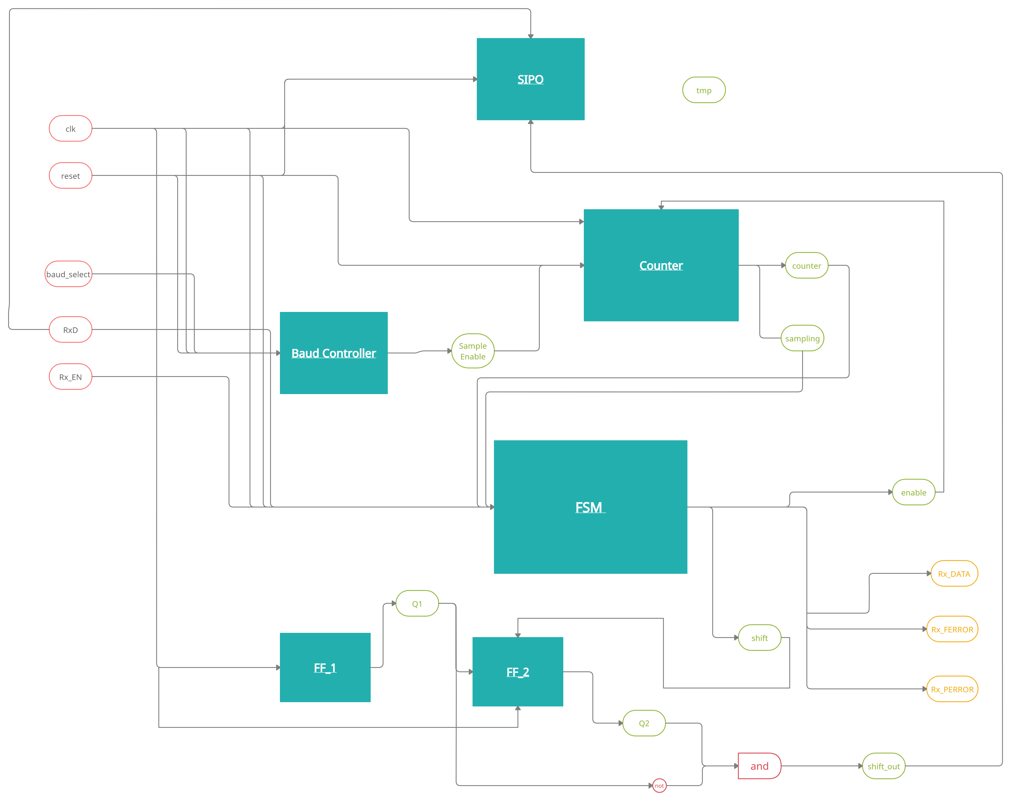
UART RECIEVER DATAFLOW

Slide 7
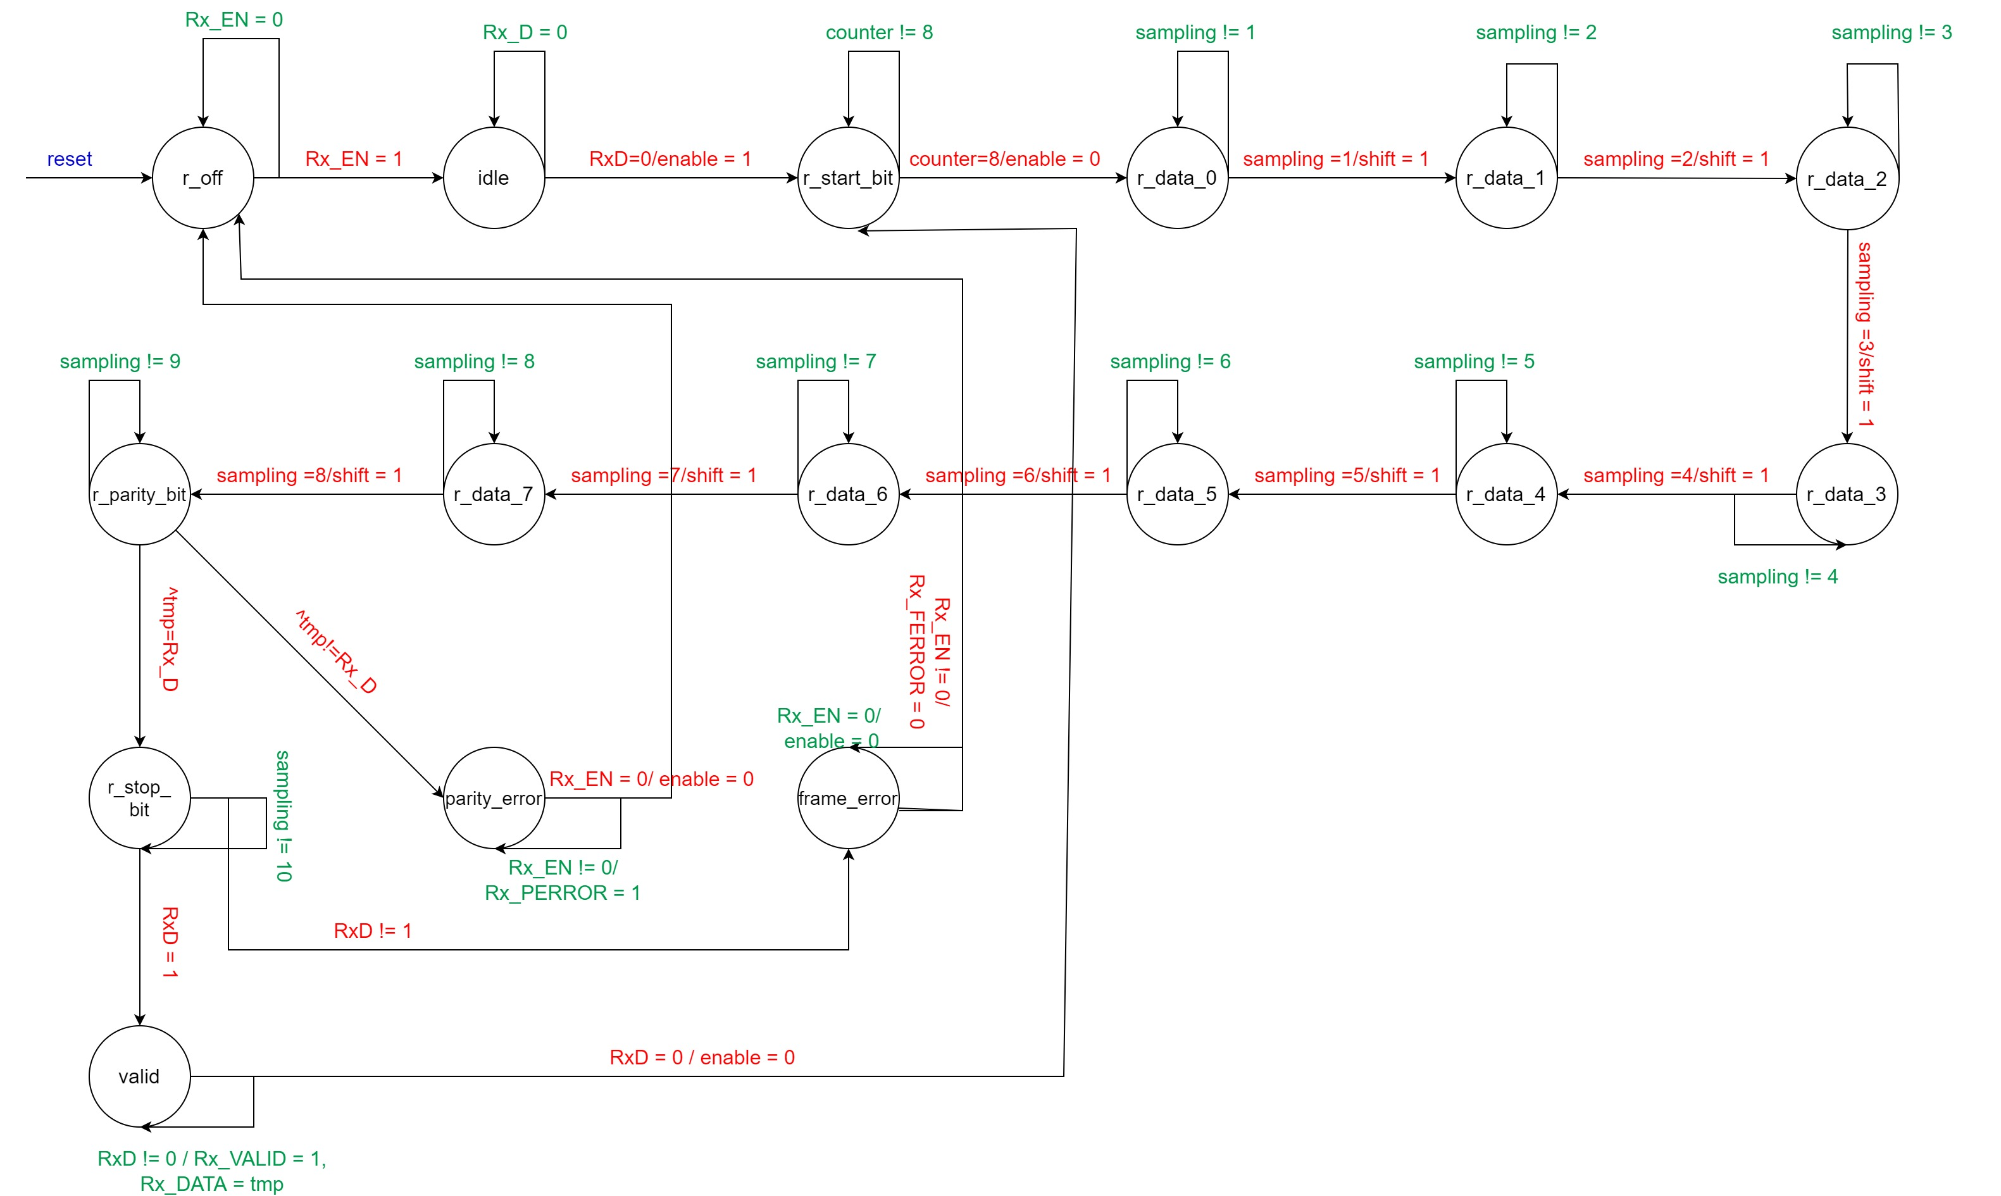
UART RECIEVER FSM

Slide 8
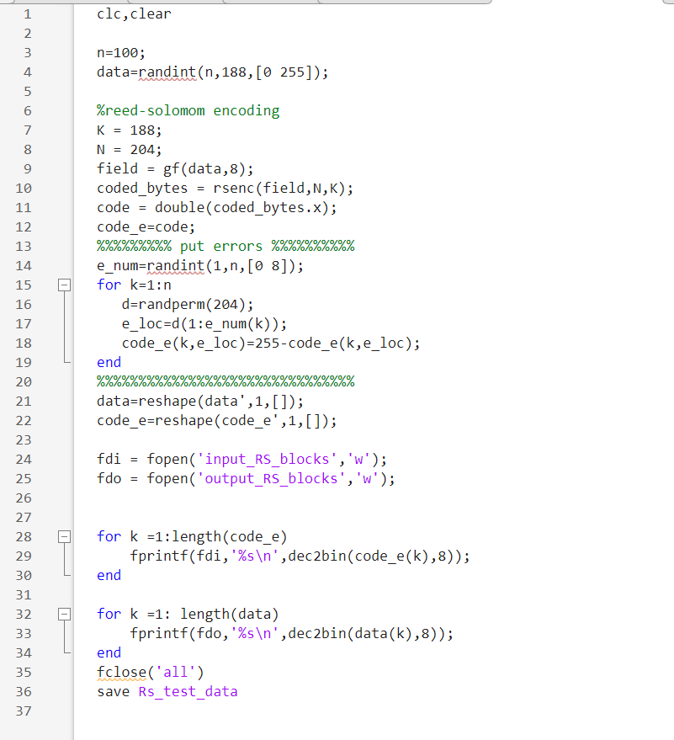
Design Simulation
We simulate the output of a Reed Solomon Encoder and a UART Transmitter that sends 8 bits at baud rate speed of 115200.
The input is an 8-bit register and in order to start decoding it needs 204 bytes.
The combinations of inputs are unlimited, because there is a Matlab script that generates vectors for input and output. We simulate using 100 of them

Slide 9
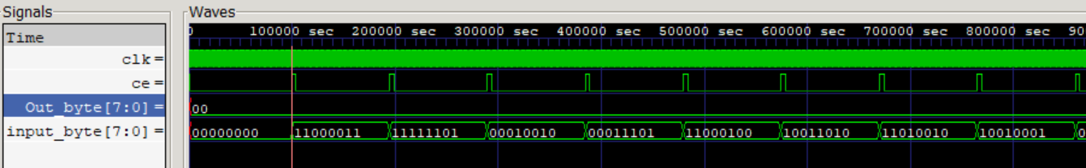
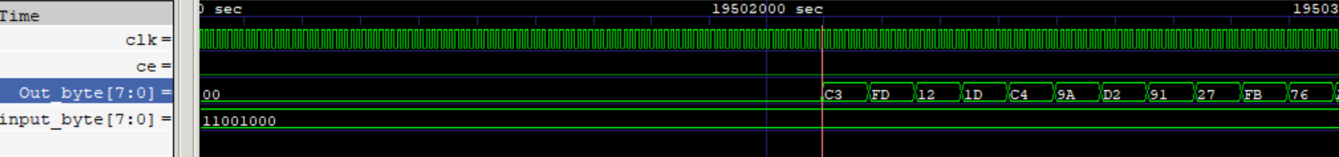
Design Simulation
Input Transmission
Decoding

Slide 10
Synthesis Flow
Gate-Level
Design
RTL
Synthesis
(Genus)
Standard Delay Format File(SDF)

Slide 11
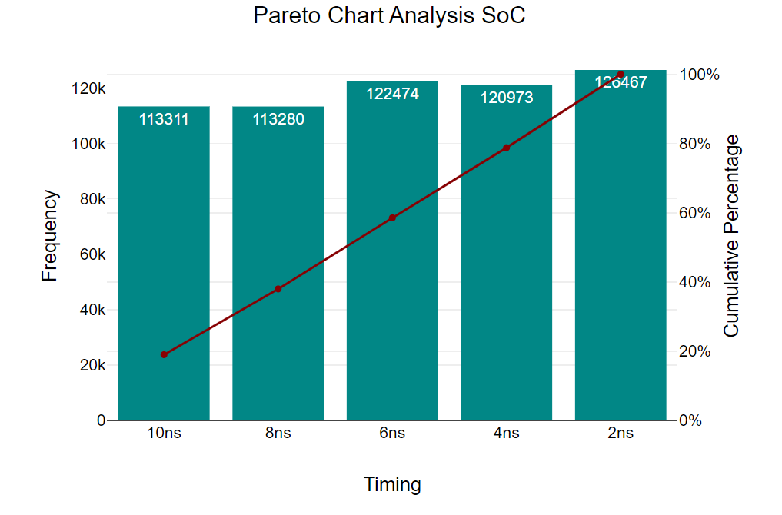
Synthesis Process
Top Down Synthesis
Clock | 10ns | 8ns | 6ns | 4ns | 2ns
Area | 113311 | 113280 | 122474 | 120973 | 126467
Power | 14222513 | 16279377 | 22475146 | 32177966 | 63412343
Slack | 7543 | 5688 | 3447 | 1472 | 12
Based on these results, we concluded on the design with 4ns Period

Slide 12
Synthesis Flow
Gate-Level
Design
RTL
Synthesis
(Genus)
Post-Synthesis
Simulation
Standard Delay Format File(SDF)

Slide 13
Post-Synthesis Simulation
We used the Gate-Level design and the SDF file, on Incicive to validate the functionality of the design
Notes:
Το τρεξαμε σε αυτοματο testbench πηρε πολύ ωρα το simulation και για αυτό φαινεται μονο για 2 inputs και χρησιμοποιησαμε το icarus λογω lag

Slide 14
Synthesis Flow
Standard Parasitic Exchange Format (SPEF)
Gate-Level
Design
RTL
Synthesis
(Genus)
Post-Synthesis
Simulation
Place and Route
Standard Delay Format File(SDF)

Slide 15
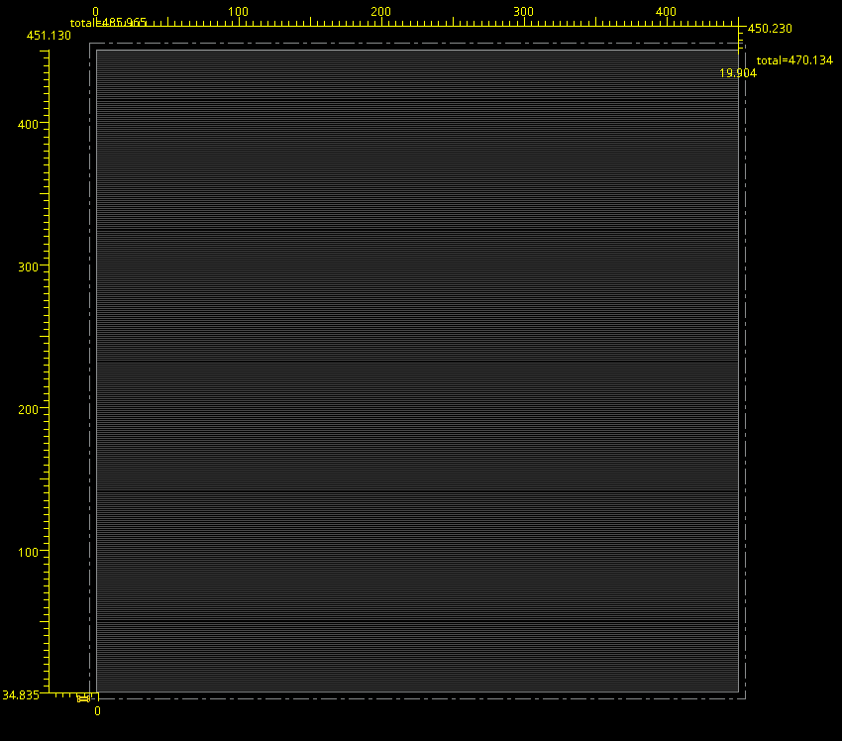
FloorPlan
Firstly, we tried core utilization 0.6 to 0.8 but the design had negative slack on Timing Report, so we decide to change the dimensions from 380x380 to 450x450 and core utilization 0.6

Slide 16
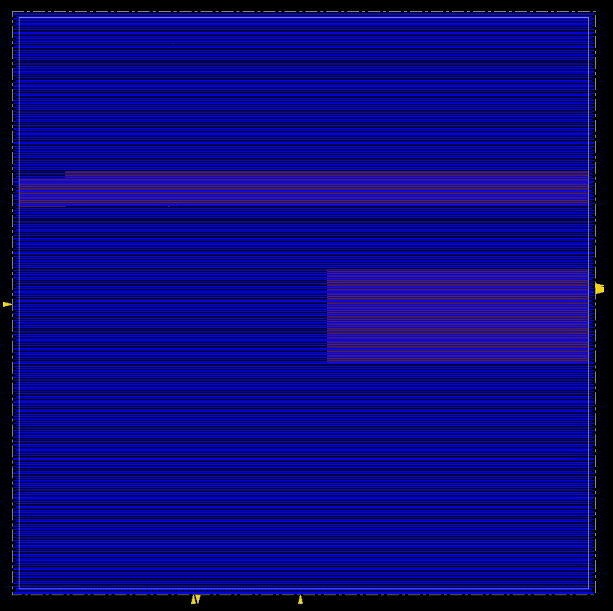
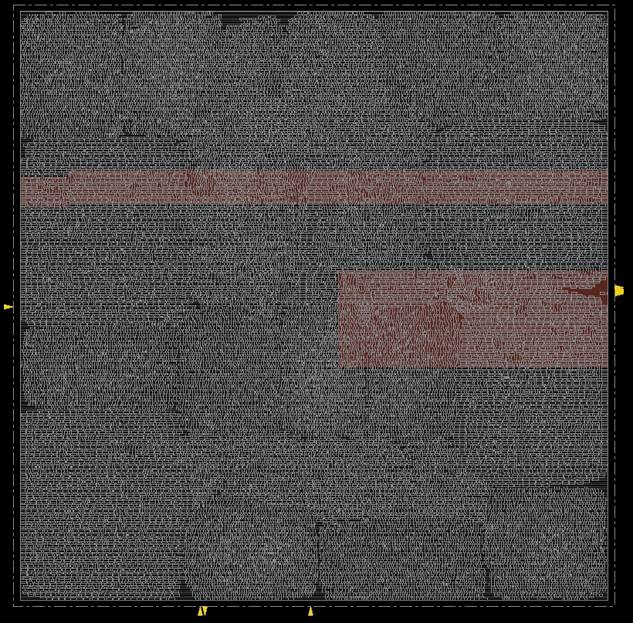
Power Routing and standard cells Placement
We assigned VDD and VSS on metal 1 and 2 respectively, and we completed the Power Routing. Afterwards, we proceeded to the standard cells Placement

Slide 17
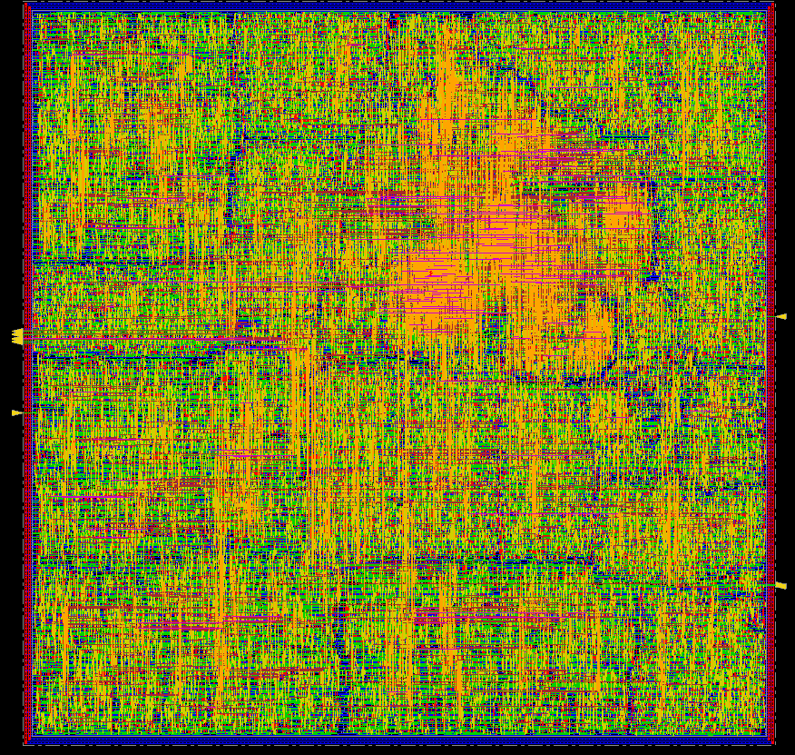
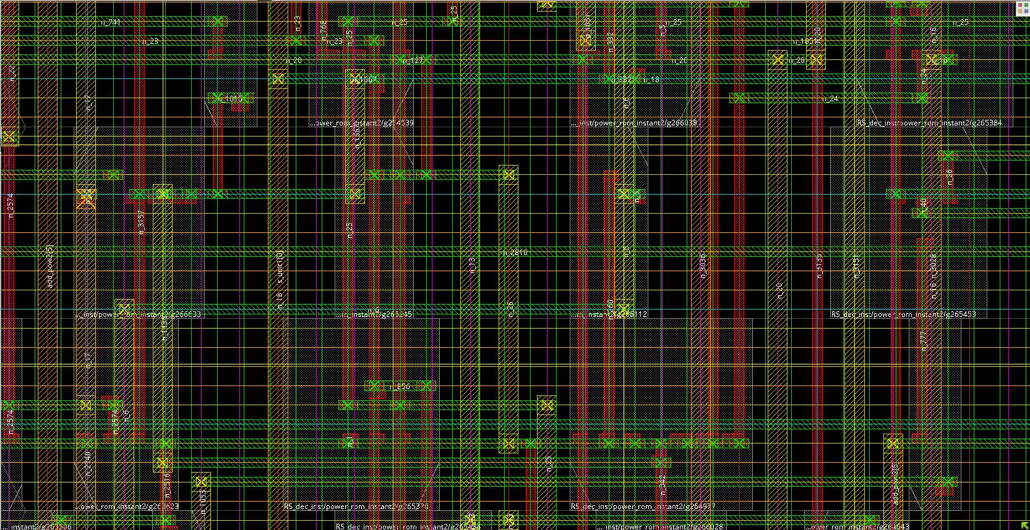
Clock Tree Synthesis and NanoRouting
We continued the process with Clock Tree Synthesis and Nano-Routing which connects all the data signals, and we get the final view of design below
Notes:
Το δεξιά είναι zoom και βάλαμε buffers και inverters στο CTS για να έχουμε ομοιόμορφο ρολόι

Slide 18
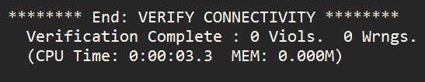
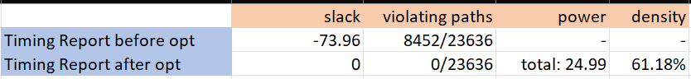
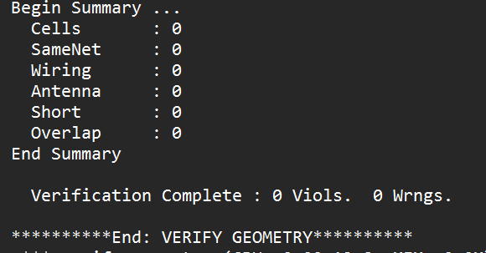
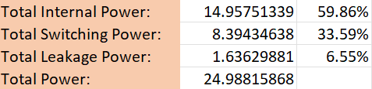
Final Reports and Verifications
After Nano-Routing we proceeded with the final reports of Timing and Power. After some optimizations we get the below results. Finally, we validate the design with the verifications of Antenna, Connectivity and Geometry.
Notes:
Το δεξιά είναι zoom και βάλαμε buffers και inverters στο CTS για να έχουμε ομοιόμορφο ρολόι

Slide 19
Thanks for your Attention!
Happy Summer! (Όσο έμεινε)

